Slide 1
Aura Essentials
Group Members:
Ethen Mathew
Reyhan Renjith
Adinath p
A P Girishankar

Slide 2
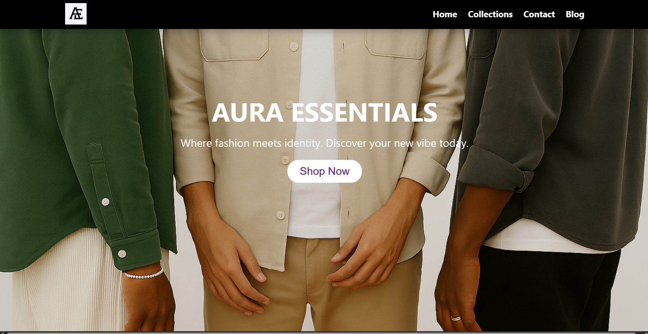
The main page

Slide 3
The top navigation bar is designed to stay fixed at the top of the page using position: fixed, ensuring that it remains visible even while scrolling. On the left side, it features a logo image (aep2.jpg), and on the right side, it displays a horizontal menu with navigation links. These links are styled using display: flex with a gap of 25px for proper spacing, and they are given a white color that changes to a soft pinkish shade (#ceadad) when hovered over, providing a pleasant user interaction. A subtle box-shadow is applied to the navbar to create a slight depth effect, helping it stand out against the rest of the content.
Below the navbar is the main banner or "hero" section, which is the first visual element users see upon landing on the site. It features a full-screen background image (esp5.png) styled with object-fit: cover to ensure it fills the screen proportionally without distortion. Over this image is an .overlay section that centers and presents the main content — a large, bold title ("AURA ESSENTIALS"), a short descriptive tagline, and a prominent call-to-action button labeled "Shop Now." This button is linked to the #Category section of the page and includes a hover effect that changes its background color to a light grey, enhancing interactivity. This combination of layout and styling creates a clean, engaging, and responsive user experience.

Slide 4
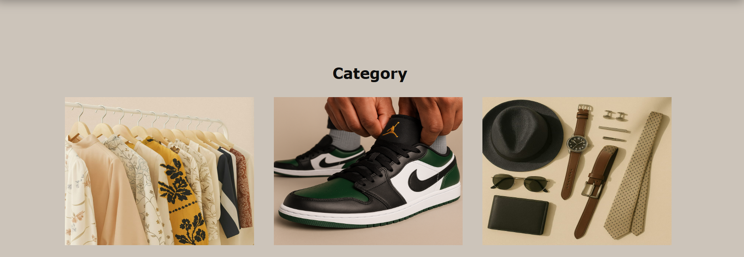

Slide 5
The Category section introduces the main product types offered on the website — Clothing Collections, Shoes, and Accessories. It begins with a heading labeled "Category" followed by a horizontally arranged layout of three product cards inside a container styled with display: flex and a left margin for spacing. Each product card (.content, .content2, and .content3) holds an image representing that category. These cards have fixed dimensions and are styled consistently to ensure a uniform layout.
Each image completely fills its container using width: 100% and height: 100%. Positioned absolutely over each image is a hidden overlay (.collection, .shoes, and .Accessories) that appears when the user hovers over the card. These overlays use a semi-transparent black background (rgba(0, 0, 0, 0.7)) and are centered using flexbox. On hover, the opacity changes from 0 to 1 with a smooth transition, revealing a product label and a "SHOP NOW" button.
Each button is styled using the .btn class with a dark red background (rgb(158, 71, 71)), white text, and slightly rounded corners. The button links to external pages where users can explore or purchase items in that category. This hover effect adds interactivity and makes the section visually engaging while also guiding users to explore specific product collections.

Slide 6
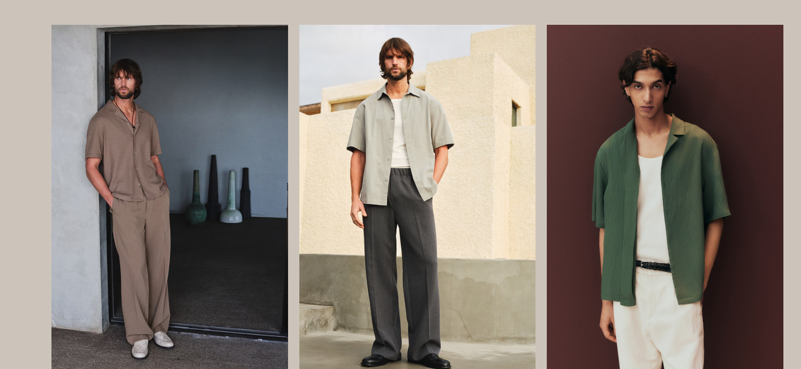
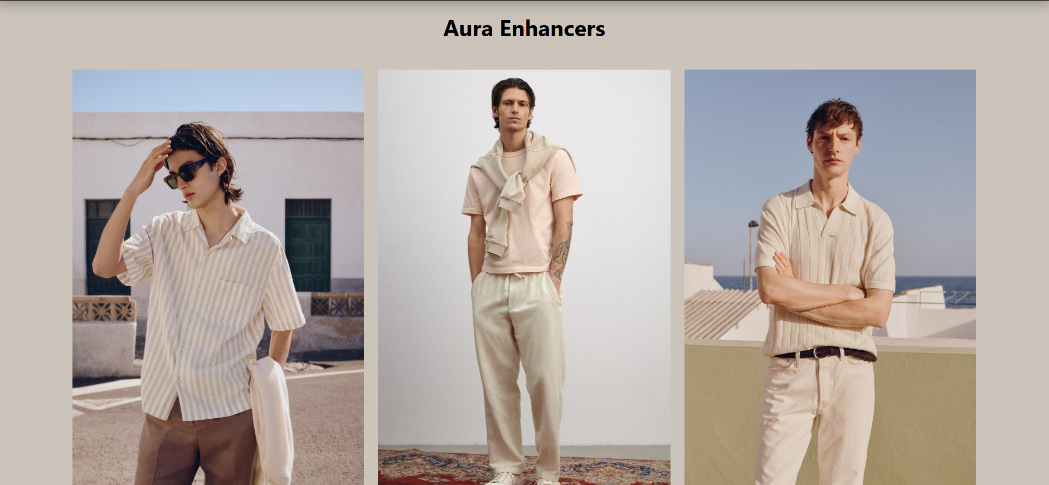
Aura Enhancers

Slide 7
The “Aura Enhancers” section showcases a grid of fashion items arranged in two rows. Each row contains three product image blocks placed inside a flex container using .row with display: flex, flex-wrap: wrap, and justify-content: center, which ensures responsive alignment and spacing between items. Each product is wrapped inside a .shirt-container, which is relatively positioned to allow precise placement of interactive elements on top of the product image.
Each product image (.p1p) is given a large fixed height (80vh) to make it visually dominant. Overlaid on these images are small clickable dot icons, implemented using anchor tags (<a>) with the classes .dot, .dot2, and .dot3. These dots act as interactive hotspots, linking to detailed pages (like buy 1.html) with product-specific query parameters.
The dots are absolutely positioned over different parts of the shirt using top, left, and transform properties, allowing them to float precisely over areas of the image. Their child image (dot.png) is styled to have a subtle inverted look using filter: invert(1.5) and set as visibility: hidden — possibly intended for future hover effects or interaction.
The section starts with a centered title, “Aura Enhancers”, styled using the .ae class. This entire layout creatively mixes static product display with interactive navigational elements, guiding users to specific purchase links while maintaining a clean and symmetrical design across all screen sizes.

Slide 8
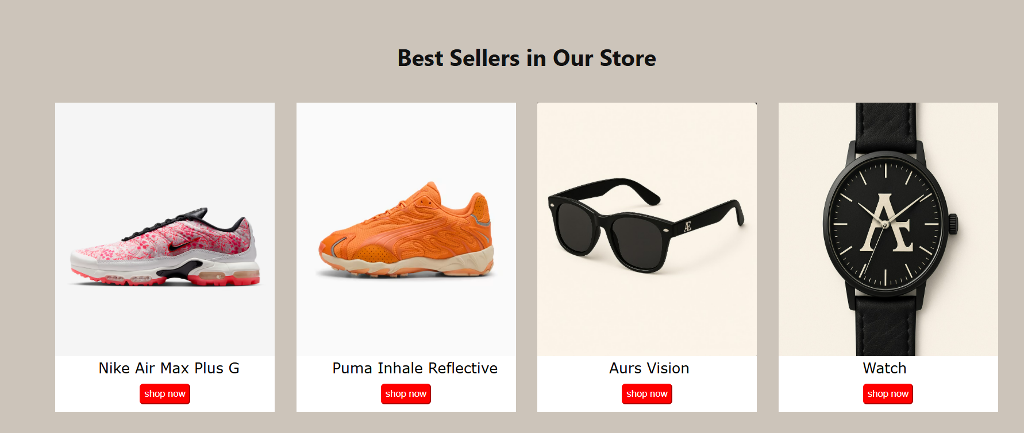

Slide 9
The “Best Sellers in Our Store” section highlights four popular products in a clean, visually balanced layout. The heading is centered using the .bs class, which applies display: flex and justify-content: center, ensuring the title aligns properly in the center with a modern, readable font.
The main container .bestseller uses display: flex and gap: 30px to arrange the product cards horizontally with spacing in between. Each individual product—whether it's shoes, glasses, or watches—is enclosed in a styled box (.bs1, .bs2, .bs3, .bs4) with a white background to help the product stand out against the page background.
Images inside each product card are fixed at 20vw width and 45vh height to maintain consistent sizing across all items. Below each image, there's a short product title (<p>) styled with readable fonts and individual left margins to ensure alignment under each image.
Each product card features a red “Shop Now” button that redirects users to the respective shopping pages when clicked, using the onclick="location.href='...' attribute. The buttons are styled with a red background, white text, rounded borders, and are centered using margin: auto.
This section serves as a visually appealing and interactive way to promote top-selling items, encouraging users to explore further while maintaining consistent design and branding across each product tile.

Slide 10
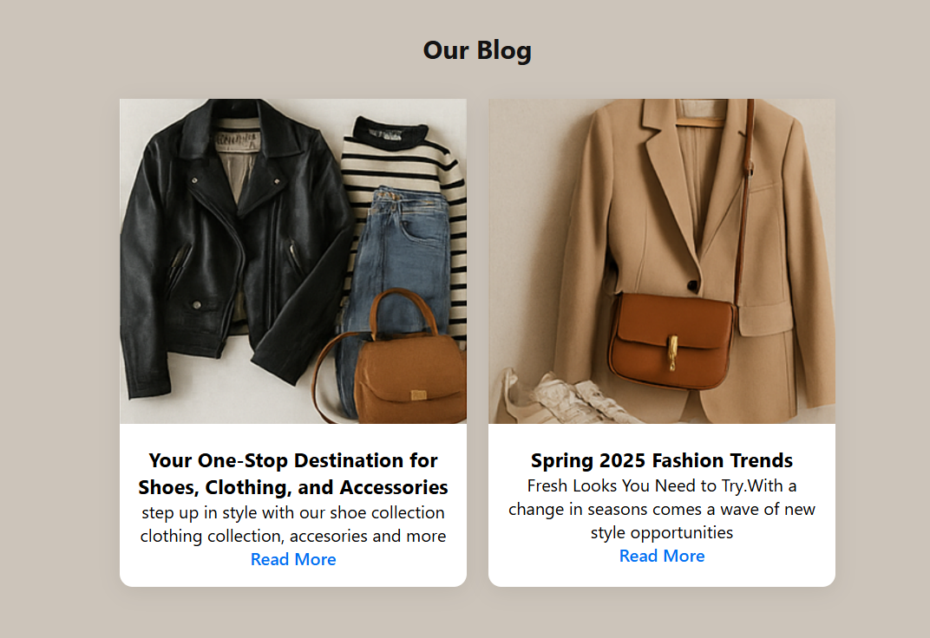

Slide 11
The “Our Blog” section presents featured blog articles in a clean, card-based layout. The entire section is centered on the page using max-width, margin: auto, and text-align: center properties. The heading <h1> is styled with padding and spacing to give it clear visibility and separation from other sections.
Inside the .bcmain container, blog cards are arranged side by side using display: flex, with gap: 20px for spacing and flex-wrap: wrap to ensure responsiveness on smaller screens.
Each individual blog card (.bc) has a white background, rounded corners (border-radius: 12px), and a soft shadow (box-shadow) to create a modern, elevated appearance. The .blogimg div contains a blog image that fills the card width and maintains proportions with object-fit: cover, giving a polished and uniform look.
Below the image, the .blogcont section includes a heading, a brief summary, and a call-to-action link. The link is styled in blue (#0070f3) with font-weight: 500 to stand out, encouraging users to "Read More" and explore the full blog post.
This section helps engage visitors with updates, fashion tips, and store-related news while maintaining visual consistency with the rest of the site.

Slide 12
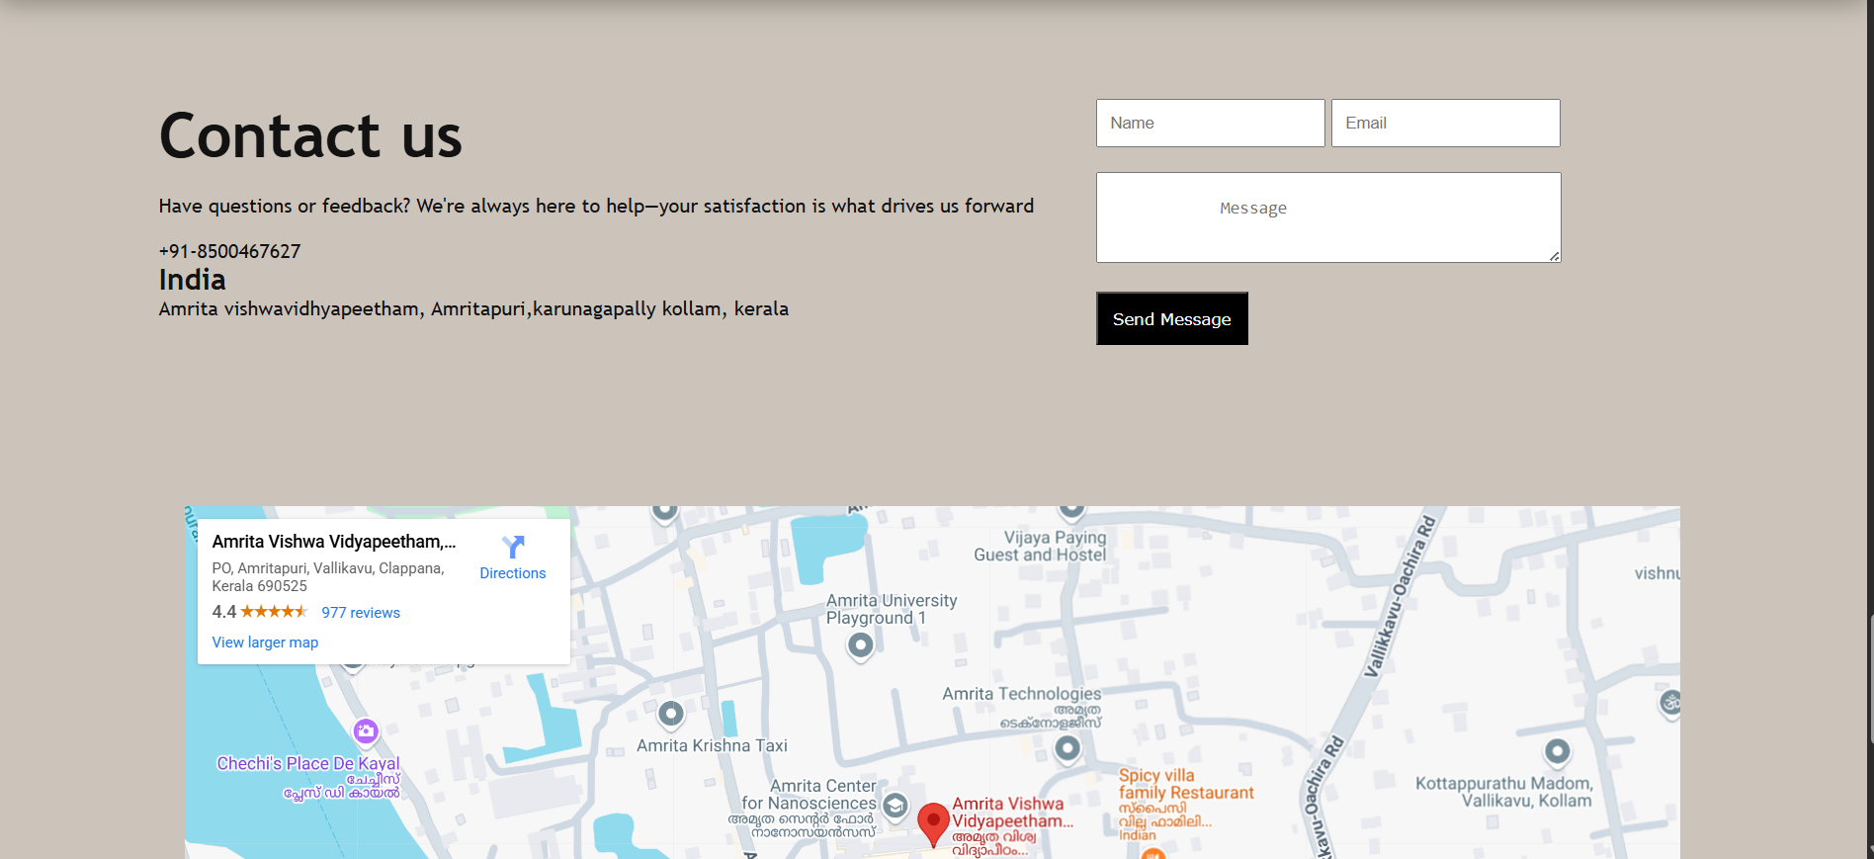

Slide 13
The Contact Us section is designed to make it easy for users to get in touch with the store team. It is divided into two parts: a contact information panel and a contact form.
The main container .contactcont uses display: flex and gap: 50px to place the two parts side by side, giving a clean and organized look. It also uses custom fonts and spacing (margin-top and margin-bottom) for professional alignment and readability.
The left side (.c1) contains a heading styled inline with a larger font size, followed by supporting text, contact number, and address. This gives users all the basic information they need at a glance.
The right side (.c2) has a contact form, built using HTML <form> tags. It uses two sections: .form1 for name and email inputs, and .form2 for a larger message field (<textarea>). Each input field is styled with padding and spacing to make the form easy to use and visually appealing. The Send Message button (.sbtn) stands out with a black background, white text, and padding, encouraging user interaction.
Below the form, a responsive Google Maps iframe is embedded within the .map div. It is centered using flex properties and takes up 80% of the page width and 550px in height. This helps users visually locate the store at Amrita Vishwa Vidyapeetham, Amritapuri, enhancing credibility and accessibility.
Together, this section offers a user-friendly way to contact the team, submit feedback, or locate the business easily.

Slide 14
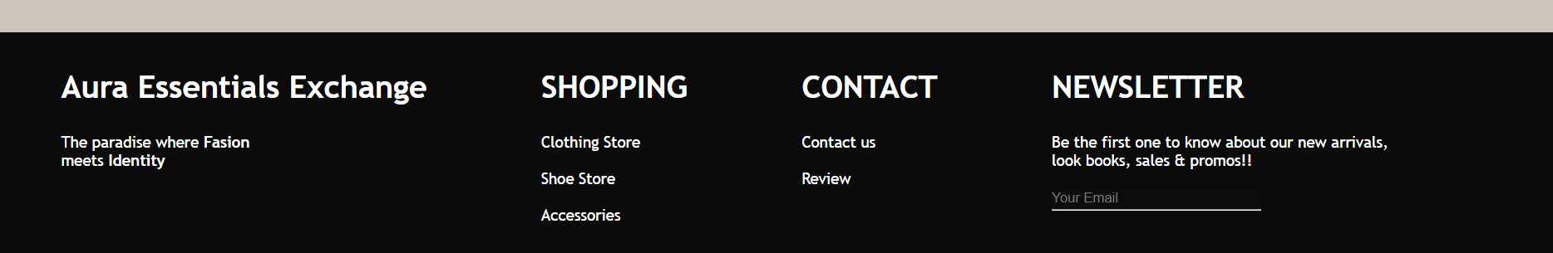
Footer

Slide 15
The Footer section acts as the closing segment of the webpage, providing essential links, branding, and contact options. Styled with a dark background (background-color: rgb(11, 11, 11)) and white text for contrast, it ensures readability and a sleek appearance.
It uses display: flex to arrange four main content blocks horizontally: .f1, .f2, .f3, and .f4. Each block serves a distinct purpose:
.f1 contains the brand name Aura Essentials Exchange styled with the .fh class, which gives the heading a bold, large font (font-size: 30px). The supporting tagline emphasizes fashion and identity, reinforcing the brand’s message.
.f2 offers Shopping links like Clothing Store, Shoe Store, and Accessories. Each link uses the .fta class, which removes underlines and sets the text color to white, maintaining design consistency.
.f3 provides Contact-related links such as "Contact us" and "Review", making it easy for users to get support or share feedback.
.f4 includes a Newsletter subscription prompt. It invites users to stay updated with new arrivals and offers. The email input field (#mail) has no border and matches the footer's dark tone for seamless blending. A horizontal line (<hr> with #f4u ID) appears below the input for stylistic separation.
Overall, the footer balances usability and design by giving visitors important links and subscription options in a clean, professional layout that wraps up the page effectively.

Slide 16
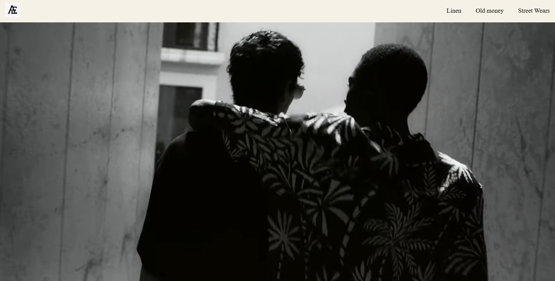
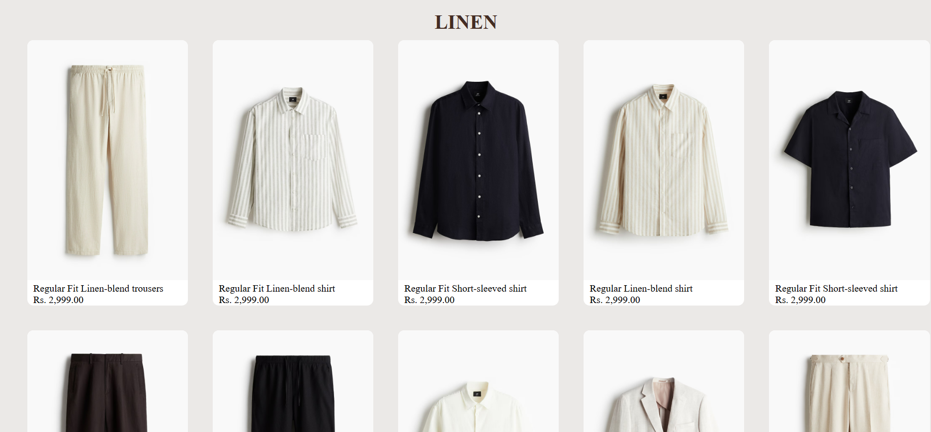
Clothing Collection

Slide 17
At the starting a vedio has been attached to the top which blends with our clothing section The clothing section of the “Aura Essentials” website is divided into three main categories: Linen, Old Money, and Streetwears. Each category is organized into its own <div> with a heading (<h1>) and a grid of product cards, allowing users to browse a curated selection of men's fashion items. Each product is displayed inside a styled container that includes an image, a description, and a price. These product cards are linked to a buy.html page using anchor tags, enabling users to view more details or make a purchase. The layout uses CSS Flexbox for responsive alignment and spacing, ensuring the items are neatly arranged across devices. The design emphasizes clarity and accessibility, making it easy for users to explore and select clothing options from each category..

Slide 18
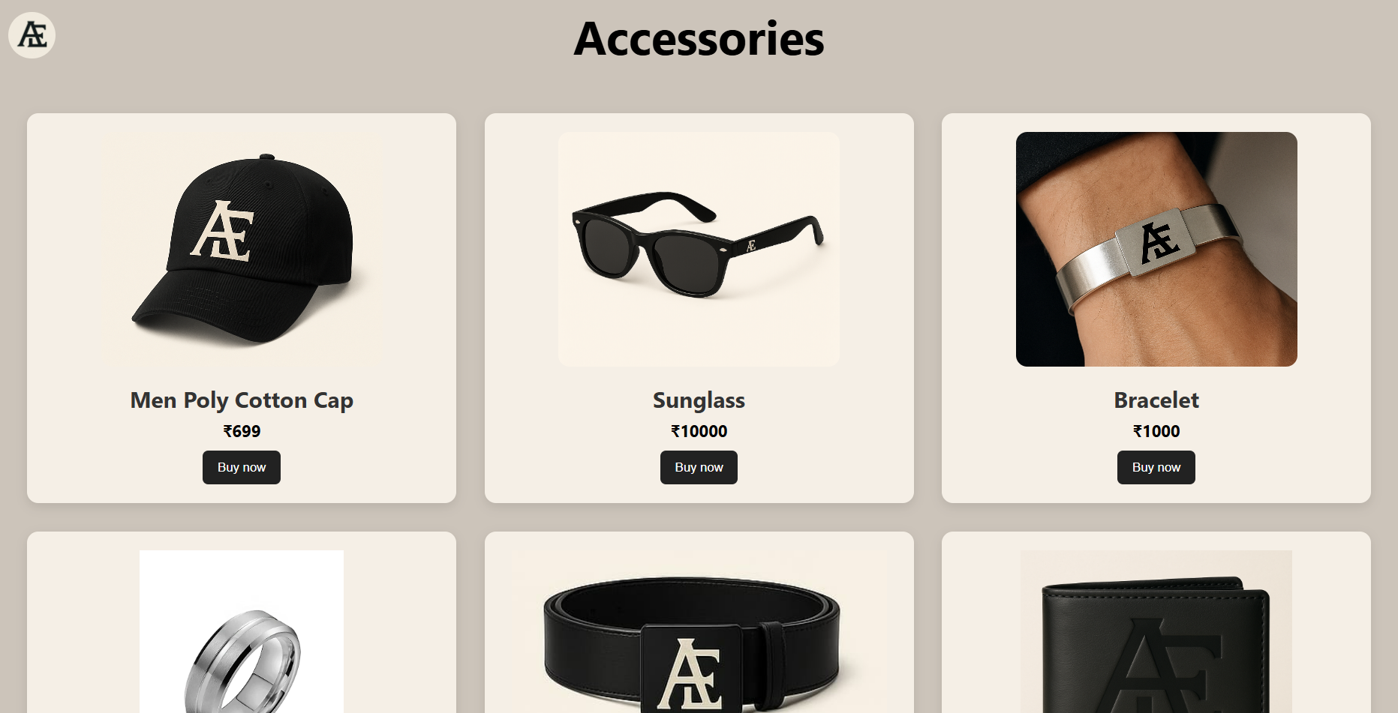

Slide 19
The Accessories section of our website is designed to showcase stylish add-ons like watches, bracelets, and rings that complement the clothing options. Each accessory is displayed within a neatly styled card that includes an image, the item name, and its price. These cards are wrapped inside a flex container (accessories-section) that ensures a responsive and organized layout. The card class styles each product block with borders, rounded corners, and hover effects, creating a modern and interactive user experience. When a user clicks on any accessory, they are redirected to the buy.html page for further action. This section enhances the overall fashion experience by offering users a complete look with trendy accessories.

Slide 20
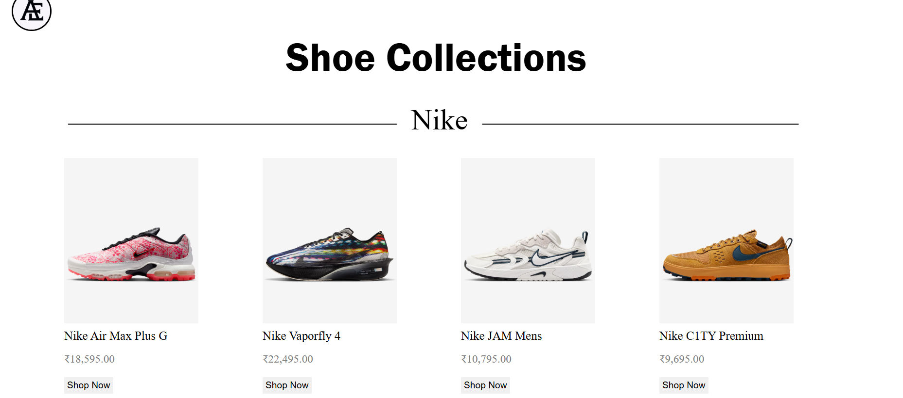
Main Page

Slide 21
Main Page
This webpage is a subpage for the main project and is a clean, well-structured e-commerce product listing page showcasing shoe collections from three major brands: Nike, Adidas, and Puma. Below is a detailed breakdown of its content and purpose:
Structure & Content
Title: "Shoe Collections" clearly indicates the page's focus on displaying footwear products.
Each brand section lists shoe models with their prices in Rupees and a "Shop Now" button for quick purchasing:
Nike:
Models: Air Max Plus G, Vaporfly 4, JAM Mens, C1TY Premium.
Prices: Ranging from ₹9,695.00 to ₹22,495.00.
Adidas:
Models: Ultraboost 1.0 DNA, BYW Select, Harden Volume 9, Originals Bad Bunny Campus.
Prices: Ranging from ₹12,807.00 to ₹17,660.00.
Puma:
Models: Puma x Lamelo Ball MB.04,Voyage NITRO™ 3,Fast-Trac NITRO™ 3, Puma Inhale ReflectivePrices: Ranging from ₹9,827.00 to ₹14,250.00
Shop now Button:
Each product includes a "Shop Now" button, encouraging immediate purchases.

Slide 22
Key Features
Currency: Prices are listed in ₹ (Indian Rupees), indicating the target market is likely India.
Simplicity: Minimalist design with clear headings, product names, prices, and buttons.
Brand Variety: Covers top athletic brands (Nike, Adidas, Puma) with a mix of performance and lifestyle shoes.
The image zooms a bit when hovered over it.
Purpose:
This is a functional product catalog page for AURA ESSENTIALS, optimized for quick browsing and conversions. The clear pricing and buttons suggest a focus on driving sales.

Slide 23
Advantages:
01
02
03
04
Simple
Easy to Use
The website has a simple and easy to understand design
The buttons and pictures are well placed to be easily understandable by the customers
Minimal
Well Categorised
The minimal design is used to apply a classy and luxurious feel to the user
The products are put under a rigid category to be understood easier.

Slide 24
— Nike
“Just Do It.”

Slide 25
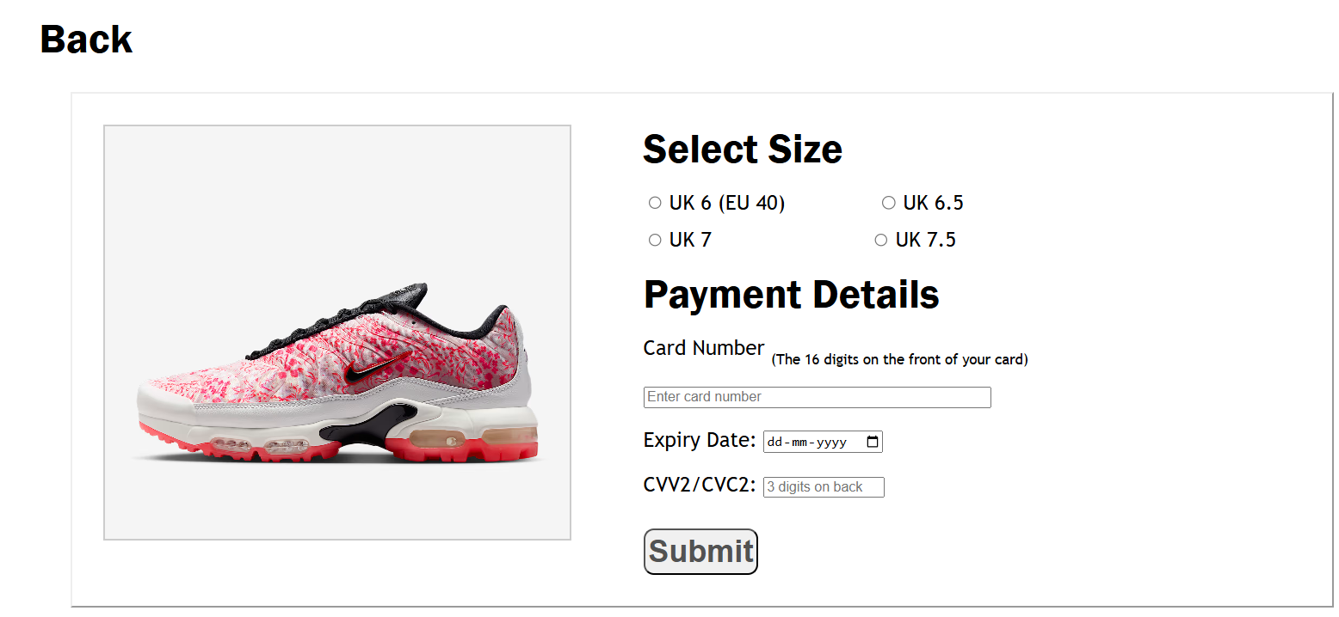

Slide 26
Page: Checkout – Size & Payment Selection
Purpose:
This streamlined checkout page ensures a seamless transition from product selection to secure payment, designed to minimize friction and maximize conversions for your footwear/apparel business.
Key Sections & Features:
User-Friendly Navigation:
"Back" Button: Allows customers to easily return to product details if adjustments are needed.
Size Selection (Tailored for Clarity):
UK/EU Sizing: Clearly labeled checkboxes for UK sizes (6–7.5) with EU conversions included to reduce confusion for international shoppers.
Intuitive UI: Radio-button-style selection for effortless interaction.
Secure Payment Integration:
Card Details: Fields for 16-digit card numbers, expiry date (dd-mm-yyyy format), and CVV/CVC ensure compliance with global payment standards.
Trust Signals: Explicit labels (e.g., "3 digits on back") guide users to input data correctly, reducing errors.
Submit Button: Prominent call-to-action to finalize purchases with confidence.

Slide 27
JavaScript
Purpose:
Only one page is created for the buy section for every product, instead of creating pages for each and every product, wasting time and space.
How it Works:
The link from main page sends a variable with the name of the image file as its value
The buy page accepts the variable and searches the repository for the image with the file name as the variable value
That image is then displayed as the preview for the buy page

Slide 28
The Preview Image
The image acts as a preview for the user to make sure that he/she is buying the correct product. The image allows zoom over hover.
The image acts as a preview
The image zooms when hovered over it
This enables the customer to truly see the beauty of our products
And the most important thing: the customer won’t miss the minute details of our carefully designed product.

Slide 29
The End.

